Slide 1

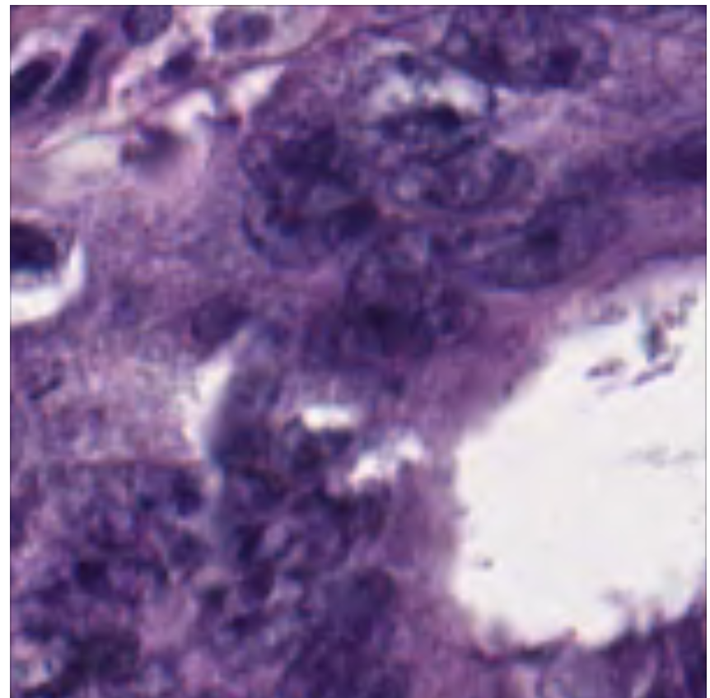
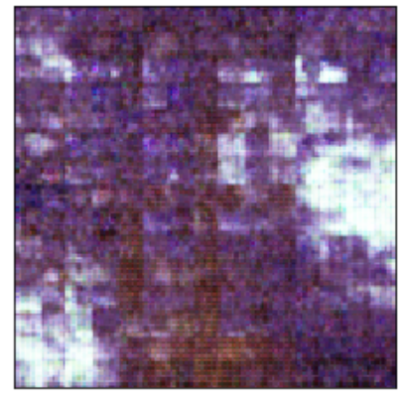
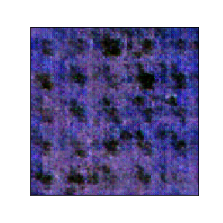
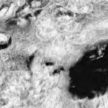
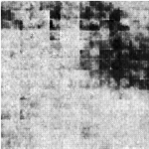
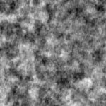
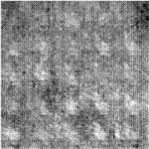
Tissue classification in primary colorectal tumors
Hanli Huang, Yingxi Yang, Kyle Kwan Long Wong
Presented by
HKUST
Department of Bioengineering
Introduction
Results
Results
Cancer remains to be one of the deadliest diseases in the world. Analysis of tumor histological images can reveal crucial information on the tissue types that make up the tumor architecture, which is associated with tumor progression, patient prognosis and selection of the most suitable treatment. Manual evaluation of histological images is a time-consuming and expensive task, despite its importance in the clinical pipeline. Deep learning methods show promise in automating this process.
The goal of this study is to train a classifier that can identify two categories of tissue (tumor and stroma) in colorectal cancer histological images. We will also explore the classifier’s performance when trained on generative images from deep convolutional generative adversarial networks (DCGANs) as well as reconstructed images from PCA^{[1]} -reduced data. Despite the visual complexity of the histological images, we hypothesize that the generated images may be able to ‘simplify’ the classification process by focusing on the most representative features.
Results
Part 1. Generative results of tumor and stroma samples
A
B
Introduction
A
B
C
D
Classification of
E
Unprocessed Tumor
F
Generative Tumor
G
Unprocessed Stroma
H
Generative Stroma
Fig.2. Comparisons of classification results with 4 different models in independent test dataset (1: training with 525 original images; 2: with 105 generative images and 420 original images; 3: with 525 original images using PCA; 4: with 105 generative images and 420 original images using PCA)
Conclusion and Future Works
Dataset
In this project, we tested different methods to support the classification of tumor tissue type in histopathological images. We explored the impact of including training images generated by a DCGAN and PCA followed by reconstruction, on the performance of a deep learning classification model.
The classification results showed that DCGAN could assist in improving model robustness by introducing additional noise. Since well-labelled medical datasets are difficult to obtain, DCGAN may be helpful in effectively ‘enlarging’ the size of the dataset for training. The model trained on PCA-reconstructed data achieved a relatively high accuracy despite a loss in overall information, suggesting the methods’ promise in retaining the important features. For future works, we hope to apply our methodology to classify other tumor types and multi-class data.
Dataset
The dataset consisted of 1250 histopathological images (150px x 150px) of colorectal cancer primary tumors obtained from the University Medical Center Mannheim pathology archive^{[2]}. 625 tumor epithelium and 625 simple stroma tissue slides represented our training and test set for the previously introduced binary classification problem. Both classes displayed a wide variation of tissue textures, stain intensity and illumination often present in the typical acquisition of histological images.
PCA-Reconstructed Tumor
PCA-Reconstructed
Generative Tumor
PCA-Reconstructed Stroma
PCA-Reconstructed
Generative Stroma
Fig.1. Example comparison of unprocessed images with generative images from DCGAN and PCA-reconstructed data
To improve the robustness of our model, we used a DCGAN to generate images that would introduce additional noise into the training set. The structure of the DCGAN consisted of 4 layers, including 3 convolutional layers and one fully connected layer selected for the generator and discriminator. The model was trained for 500 epochs and generated 105 images (20% of training size) for each class. Despite the pixelation observed in the generative tumor (Fig.1.B), it contained the major characteristics of the original (Fig.1.A). For stroma samples, we observed black distinguishable nuclei in the generative images (seen from Fig.1.C and Fig.1.D), suggesting that the DCGAN model achieved its primary objective. In order to perform PCA followed by an inverse transform to reconstruct the original images, the images were first converted into greyscale. As expected, the PCA-reconstructed images resulted in a loss of image definition due to reconstruction occurring from the eigenvectors with less variation in the dataset. Qualitative analysis shows that the PCA-reconstructed stroma samples (Fig.1.G) seemed to deviate the most from the original.
Methodology
Part 1: DCGAN^{[3]}
DCGANs are a famous variant of generative adversarial networks for image generation, which
integrates one generator and one discriminator to target the whole unsupervised learning task.
Reconstruction with PCA^{[1]}
The number of PCA components were chosen by examining the cumulative distribution of PCA eigenvalues. After applying the PCA model to every dataset, the original images were reconstructed through applying an inverse transform.
Part 2: Classification with Inception V3^{[4]}
Inception V3 was the 1st Runner Up for the image classification task in ILSVRC (ImageNet Large Scale Visual Recognition Competition) 2015.
Part 2. Classification results with deep learning
References
A pre-trained Inception V3 model was used to train a classifier for distinguishing tumor and stroma samples. We prepared 4 different datasets, including the original dataset, DCGAN generated mixed dataset, PCA dataset, and DCGAN mixed PCA dataset. 4 Models were trained on these datasets and validated on independent samples. Receiver operating characteristic (ROC) curves and precision-recall curves (PRC) were used to evaluate the performance of the models (Fig.2). The model trained on GAN generated mixed dataset shown best performance with a slightly higher AUROC (Area under ROC) score than the original one (Fig.2.A), which indicates that adding some noise into dataset could improve the robustness of the classifier. Comparison between PCA and DCGAN mixed PCA shows a similar indication. When we focus on the results of original and PCA, we believed that some information was lost during the PCA processing. However, the model trained on PCA still got an AUROC of 0.761 and AUPRC of 0.742, which means the remaining features provided quite abundant information for model training.
1. Wold S, Esbensen K, Geladi P. Principal component analysis[J]. Chemometrics and intelligent laboratory systems, 1987, 2(1-3): 37-52.
2. Kather J N, Weis C A, Bianconi F, et al. Multi-class texture analysis in colorectal cancer histology[J]. Scientific reports, 2016, 6: 27988.
3. Fang W, et al. A method for improving CNN-based image recognition using DCGAN[J]. CMC: Comput. Mater. Continua, 2018, 57(1): 167-178.
4. Ridell P, Spett H. Training set size for skin cancer classification using Google’s inception v3[J]. 2017.
Part3. Classification performance with Deep learning
Contribution
DCGAN → Yingxi YANG Dimensionality reduction → WONG, Kwan Long
Image classification → Hanli Huang

